Slide 1
Appended CH6

Slide 2
CRC Process

Slide 3
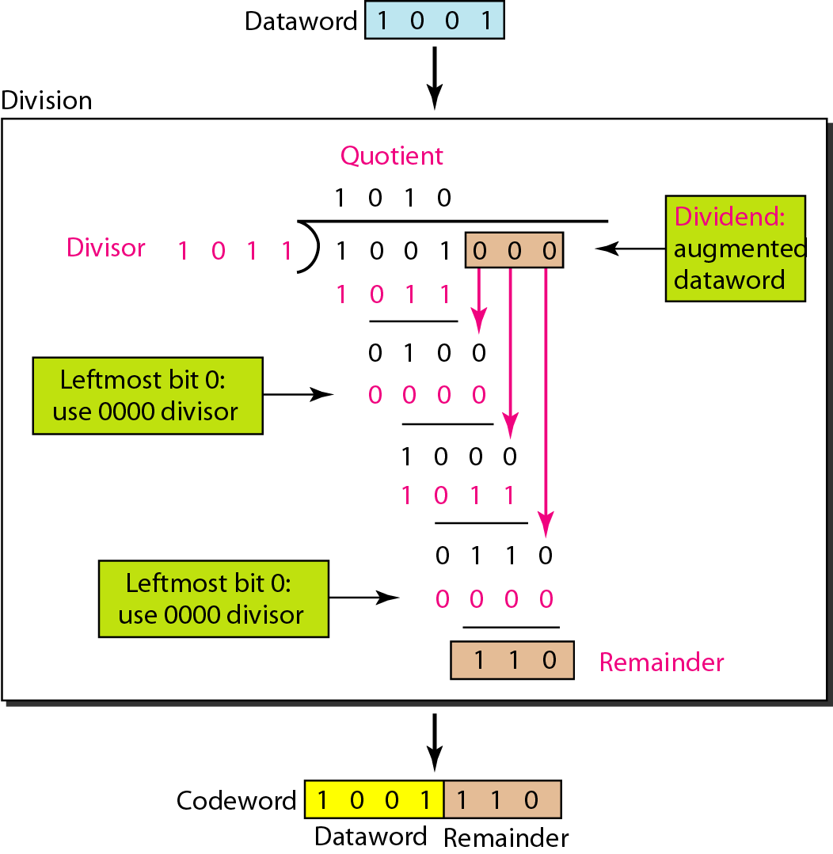
Division in CRC Encoder

Slide 4
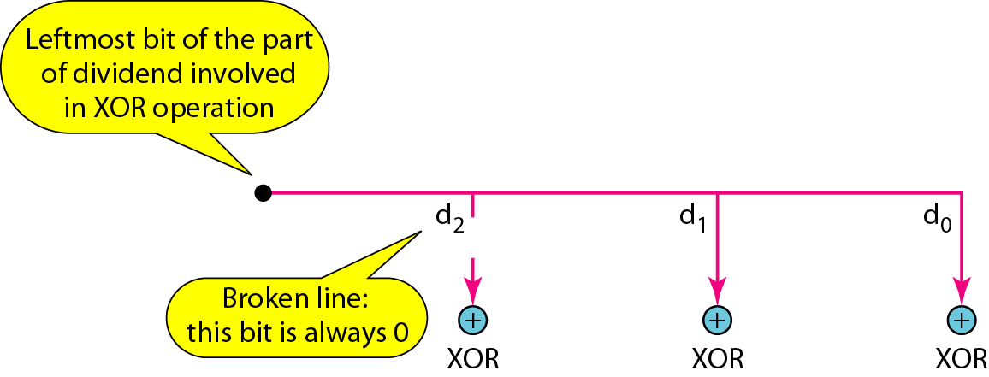
Hardware Implementation
The divisor is repeatedly XORed with part of the dividend
The divisor has n-k+1 bits which either are predefined or all 0s
n-k bits of the divisor is needed in the XOR operation. The leftmost bit is always 0

Slide 5
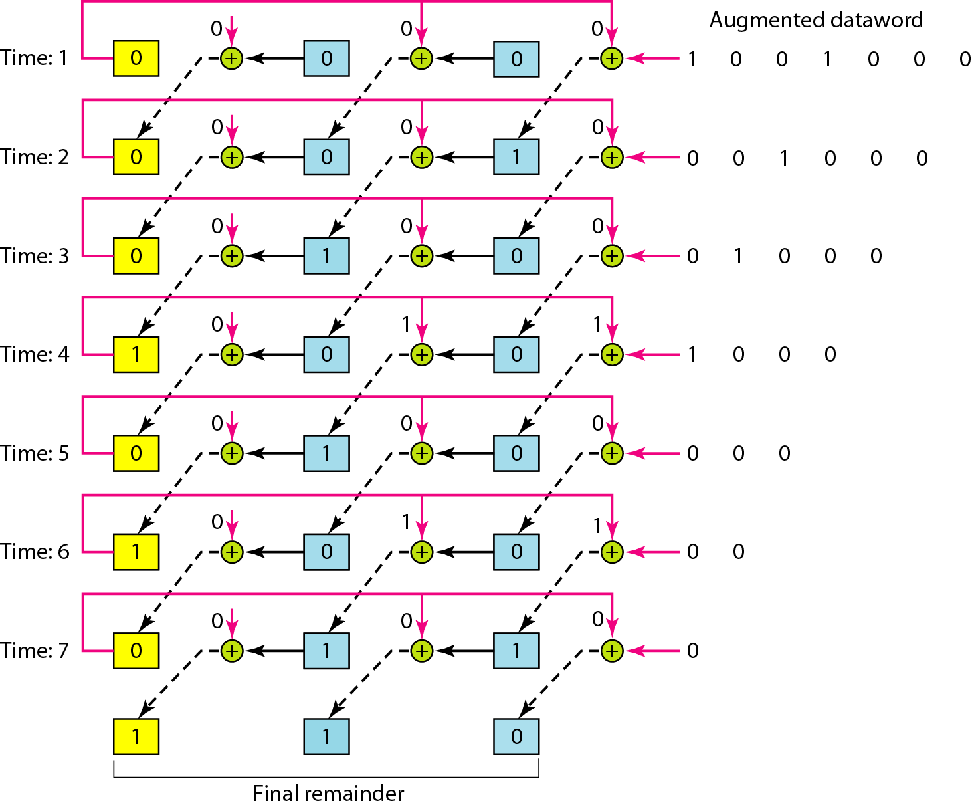
Remainder

